Slide 1
HTML Colors

Slide 2
<p style=“color:blue;”>
Hello
</p>
<hr>
<p style=“color:red;”>
Goodbye
</p>
Recap:
Hello
__________________
Goodbye

Slide 3
<p style=“color:blue;”>
Hello
</p>
<hr>
<p style=“color:red;”>
Goodbye
</p>
Recap:
Hello
__________________
Goodbye

Slide 4
<p style=“color:blue;”>
Hello
</p>
<hr>
<p style=“color:red;”>
Goodbye
</p>
Recap:
Hello
__________________
Goodbye

Slide 5
HTML Colors
There are 140 colors that have names in HTML
Red Blue Green Cyan BlanchedAlmond
Full list available at http://www.w3schools.com/colors/colors_names.asp

Slide 6
HTML Colors
There are 140 colors that have names in HTML
Red Blue Green Cyan BlanchedAlmond
Aren’t there WAY more than 140 colors??

Slide 7
HTML Color Codes
Colors in HTML can either be:
A valid color name
“red” “green” “cyan”
An RGB value
“rgb(0, 255, 0)”
A Hexadecimal (aka “hex”) color code
“#FF00FF”

Slide 8
HTML Color Codes
Colors in HTML can either be:
A valid color name
“red” “green” “cyan”
An RGB value
“rgb(0, 255, 0)”
A Hex color code
“#FF00FF”
?

Slide 9
RGB Color Encoding
The RGB Color Encoding system allows us to create colors by specifying the amount of Red, Green, and Blue in the color!

Slide 10
RGB Colors
Any color can be created
by combining
Red, Green, and Blue light
at varying intensities

Slide 11
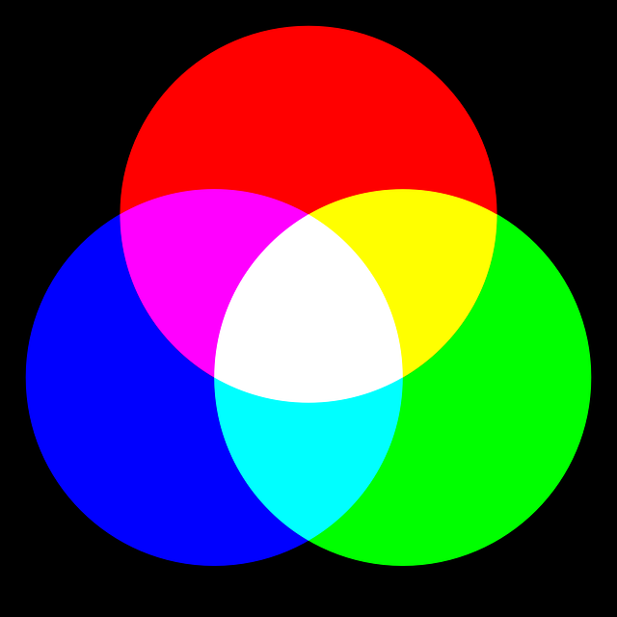
RGB Colors

Slide 12
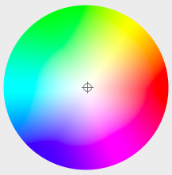
RGB Colors

Slide 13
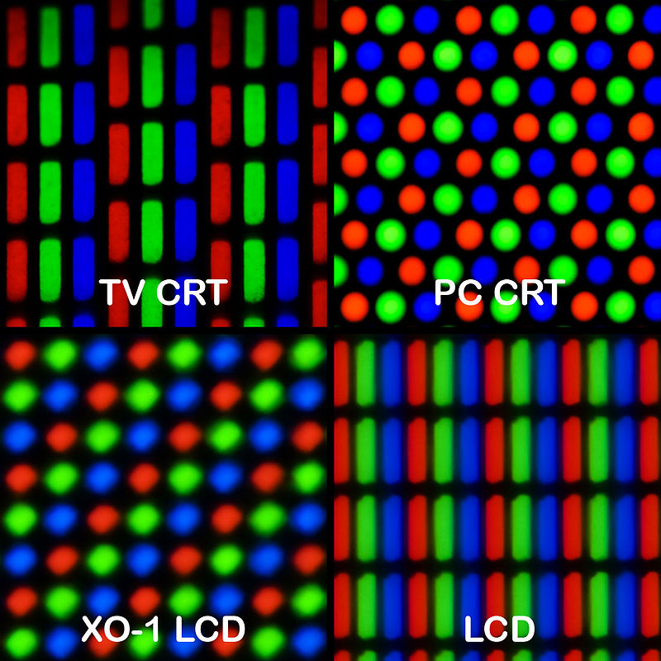
Every Pixel has R G and B
Source: Peter Halasz http://commons.wikimedia.org/wiki/File:Pixel_geometry_01_Pengo.jpg

Slide 14
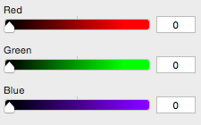
RGB Colors
A color has 3 values
R
G
B
Result: 0 0 0

Slide 15
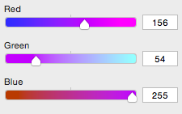
RGB Colors
A color has 3 values
R
G
B
Result: 156 54 255

Slide 16
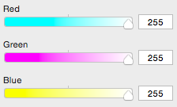
RGB Colors
A color has 3 values
R
G
B
Result: 255 255 255

Slide 17
RGB Colors
Each “color channel” gets a value in the range:
0 - 255

Slide 18
RGB Colors
Each “color channel” gets a value in the range:
0 - 255
That’s 256³ = 16,777,216 possible colors!

Slide 19
RGB Color Examples
rgb(0, 0, 0)
rgb(0, 255, 0)
rgb(0, 128, 128)
rgb(255, 255, 255)

Slide 20
RGB Color Examples
rgb(0, 0, 0)
rgb(0, 255, 0)
rgb(0, 128, 128)
rgb(255, 255, 255)

Slide 21
RGB Color Examples
rgb(0, 0, 0)
rgb(0, 255, 0)
rgb(0, 128, 128)
rgb(255, 255, 255)

Slide 22
RGB Color Examples
rgb(0, 0, 0)
rgb(0, 255, 0)
rgb(0, 128, 128)
rgb(255, 255, 255)

Slide 23
Hexadecimal Color Codes
#000000
#00FF00
#008080
#FFFFFF

Slide 24
Hexadecimal Color Codes
#000000
#00FF00
#008080
#FFFFFF
?

Slide 25
Hexadecimal Color Codes
The decimal numbering system has 10 digits
0 1 2 3 4 5 6 7 8 9

Slide 26
Counting in Decimal
The decimal numbering system has 10 digits
0 1 2 3 4 5 6 7 8 9
0₁₀

Slide 27
Counting in Decimal
The decimal numbering system has 10 digits
0 1 2 3 4 5 6 7 8 9
1₁₀

Slide 28
Counting in Decimal
The decimal numbering system has 10 digits
0 1 2 3 4 5 6 7 8 9
2₁₀

Slide 29
Counting in Decimal
The decimal numbering system has 10 digits
0 1 2 3 4 5 6 7 8 9
3₁₀

Slide 30
Counting in Decimal
The decimal numbering system has 10 digits
0 1 2 3 4 5 6 7 8 9
4₁₀

Slide 31
Counting in Decimal
The decimal numbering system has 10 digits
0 1 2 3 4 5 6 7 8 9
5₁₀

Slide 32
Counting in Decimal
The decimal numbering system has 10 digits
0 1 2 3 4 5 6 7 8 9
6₁₀

Slide 33
Counting in Decimal
The decimal numbering system has 10 digits
0 1 2 3 4 5 6 7 8 9
7₁₀

Slide 34
Counting in Decimal
The decimal numbering system has 10 digits
0 1 2 3 4 5 6 7 8 9
8₁₀

Slide 35
Counting in Decimal
The decimal numbering system has 10 digits
0 1 2 3 4 5 6 7 8 9
9₁₀

Slide 36
Counting in Decimal
The decimal numbering system has 10 digits
0 1 2 3 4 5 6 7 8 9
10₁₀

Slide 37
Counting in Decimal
The decimal numbering system has 10 digits
0 1 2 3 4 5 6 7 8 9
11₁₀

Slide 38
Counting in Decimal
The decimal numbering system has 10 digits
0 1 2 3 4 5 6 7 8 9
12₁₀

Slide 39
Counting in Decimal
The decimal numbering system has 10 digits
0 1 2 3 4 5 6 7 8 9
...

Slide 40
Counting in Decimal
The decimal numbering system has 10 digits
0 1 2 3 4 5 6 7 8 9
97₁₀

Slide 41
Counting in Decimal
The decimal numbering system has 10 digits
0 1 2 3 4 5 6 7 8 9
98₁₀

Slide 42
Counting in Decimal
The decimal numbering system has 10 digits
0 1 2 3 4 5 6 7 8 9
99₁₀

Slide 43
Hexadecimal Color Codes
The hexadecimal numbering system has 16 digits
0 1 2 3 4 5 6 7 8 9 A B C D E F

Slide 44
Counting in Hex
The hexadecimal numbering system has 16 digits
0 1 2 3 4 5 6 7 8 9 A B C D E F
0₁₆

Slide 45
Counting in Hex
The hexadecimal numbering system has 16 digits
0 1 2 3 4 5 6 7 8 9 A B C D E F
1₁₆

Slide 46
Counting in Hex
The hexadecimal numbering system has 16 digits
0 1 2 3 4 5 6 7 8 9 A B C D E F
2₁₆

Slide 47
Counting in Hex
The hexadecimal numbering system has 16 digits
0 1 2 3 4 5 6 7 8 9 A B C D E F
3₁₆

Slide 48
Counting in Hex
The hexadecimal numbering system has 16 digits
0 1 2 3 4 5 6 7 8 9 A B C D E F
4₁₆

Slide 49
Counting in Hex
The hexadecimal numbering system has 16 digits
0 1 2 3 4 5 6 7 8 9 A B C D E F
5₁₆

Slide 50
Counting in Hex
The hexadecimal numbering system has 16 digits
0 1 2 3 4 5 6 7 8 9 A B C D E F
6₁₆

Slide 51
Counting in Hex
The hexadecimal numbering system has 16 digits
0 1 2 3 4 5 6 7 8 9 A B C D E F
7₁₆

Slide 52
Counting in Hex
The hexadecimal numbering system has 16 digits
0 1 2 3 4 5 6 7 8 9 A B C D E F
8₁₆

Slide 53
Counting in Hex
The hexadecimal numbering system has 16 digits
0 1 2 3 4 5 6 7 8 9 A B C D E F
9₁₆

Slide 54
Counting in Hex
The hexadecimal numbering system has 16 digits
0 1 2 3 4 5 6 7 8 9 A B C D E F
A₁₆

Slide 55
Counting in Hex
The hexadecimal numbering system has 16 digits
0 1 2 3 4 5 6 7 8 9 A B C D E F
B₁₆

Slide 56
Counting in Hex
The hexadecimal numbering system has 16 digits
0 1 2 3 4 5 6 7 8 9 A B C D E F
C₁₆

Slide 57
Counting in Hex
The hexadecimal numbering system has 16 digits
0 1 2 3 4 5 6 7 8 9 A B C D E F
D₁₆

Slide 58
Counting in Hex
The hexadecimal numbering system has 16 digits
0 1 2 3 4 5 6 7 8 9 A B C D E F
E₁₆

Slide 59
Counting in Hex
The hexadecimal numbering system has 16 digits
0 1 2 3 4 5 6 7 8 9 A B C D E F
F₁₆

Slide 60
Counting in Hex
The hexadecimal numbering system has 16 digits
0 1 2 3 4 5 6 7 8 9 A B C D E F
10₁₆

Slide 61
Counting in Hex
The hexadecimal numbering system has 16 digits
0 1 2 3 4 5 6 7 8 9 A B C D E F
11₁₆

Slide 62
Counting in Hex
The hexadecimal numbering system has 16 digits
0 1 2 3 4 5 6 7 8 9 A B C D E F
...₁₆

Slide 63
Counting in Hex
The hexadecimal numbering system has 16 digits
0 1 2 3 4 5 6 7 8 9 A B C D E F
F0₁₆

Slide 64
Counting in Hex
The hexadecimal numbering system has 16 digits
0 1 2 3 4 5 6 7 8 9 A B C D E F
F1₁₆

Slide 65
Counting in Hex
The hexadecimal numbering system has 16 digits
0 1 2 3 4 5 6 7 8 9 A B C D E F
F2₁₆

Slide 66
Counting in Hex
The hexadecimal numbering system has 16 digits
0 1 2 3 4 5 6 7 8 9 A B C D E F
...₁₆

Slide 67
Counting in Hex
The hexadecimal numbering system has 16 digits
0 1 2 3 4 5 6 7 8 9 A B C D E F
FD₁₆

Slide 68
Counting in Hex
The hexadecimal numbering system has 16 digits
0 1 2 3 4 5 6 7 8 9 A B C D E F
FE₁₆

Slide 69
Counting in Hex
The hexadecimal numbering system has 16 digits
0 1 2 3 4 5 6 7 8 9 A B C D E F
FF₁₆

Slide 70
Hex Color Codes
We can specify RGB colors using Hex digits
00₁₆ = 0₁₀
FF₁₆ = 255₁₀

Slide 71
Hex Color Codes
We can specify RGB colors using Hex digits
00₁₆ = 0₁₀
FF₁₆ = 255₁₀
#FF0000

Slide 72
Hex Color Codes
We can specify RGB colors using Hex digits
00₁₆ = 0₁₀
FF₁₆ = 255₁₀
#FF0000
#rrggbb

Slide 73
Hex Color Codes
We can specify RGB colors using Hex digits
00₁₆ = 0₁₀
FF₁₆ = 255₁₀
#FF0000
#rrggbb

Slide 74
Hex Color Codes
We can specify RGB colors using Hex digits
00₁₆ = 0₁₀
FF₁₆ = 255₁₀
#FF0000
#FFFFFF
#rrggbb

Slide 75
Hex Color Codes
We can specify RGB colors using Hex digits
00₁₆ = 0₁₀
FF₁₆ = 255₁₀
#FF0000
#FFFFFF
#rrggbb

Slide 76
Color Example
Example Color:

Slide 77
Color Example
Example Color:
Name: “DarkBlue”

Slide 78
Color Example
Example Color:
Name: “DarkBlue”
RGB: “rgb(0, 0, 139)”

Slide 79
Color Example
Example Color:
Name: “DarkBlue”
RGB: “rgb(0, 0, 139)”
Hex: “#00008B”

Slide 80
Let’s see this in the editor!

